Slide 1

Sales predictions project
Prepared by: Tilepbergenov Altynbek
Checked by: Brenda Hungerford, instructor at CodingDojo

Slide 2
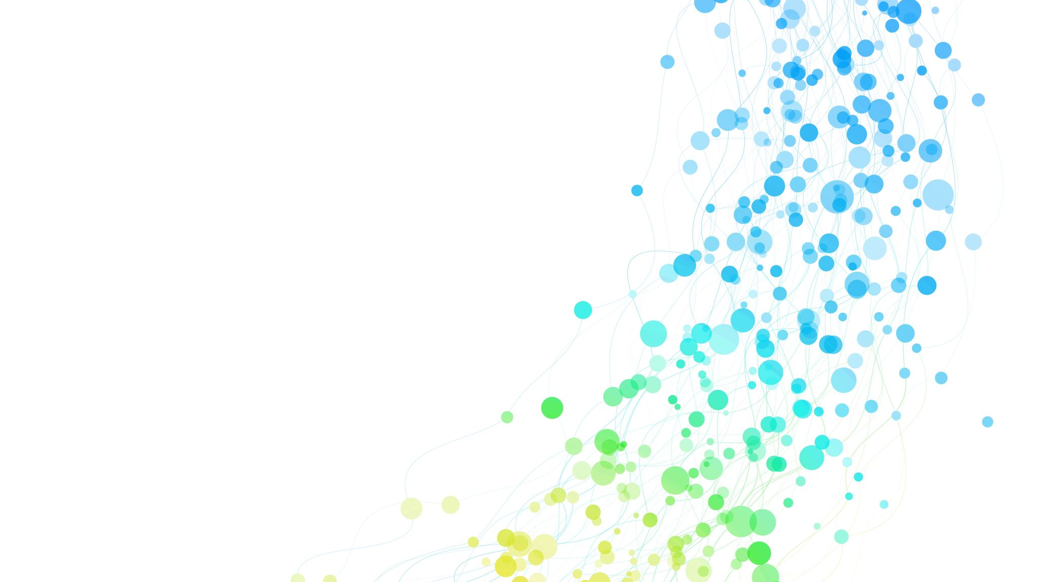
OVERVIEW
Purpose of the project: To predict the sales using the data given by the outlets and train models implementing the knowledge which was obtained during the bootcamp at Coding Dojo
Parts of the project:
Data analysis
Data visualization
Data exploratory
Pre processing to machine learning
Modeling the data

Slide 3
Part 1 Data cleaning and exploratory
1) Dropped any duplicates.
2) Identified missing values.
3) Decided on how to address the missing values and do it
4) Confirmed that there are no missing values after addressing them.
5) Found and fixed any inconsistent categories of data
6) For any numerical columns, obtained the summary statistics of each (min, max, mean)

Slide 4

Part 2 Statistical analysis
My project includes these statistical features:
Histogram to view the distributions of various features in your dataset.
Boxplot to view statistical summaries of various features in your dataset.
Heatmap of the correlation between features

Slide 5
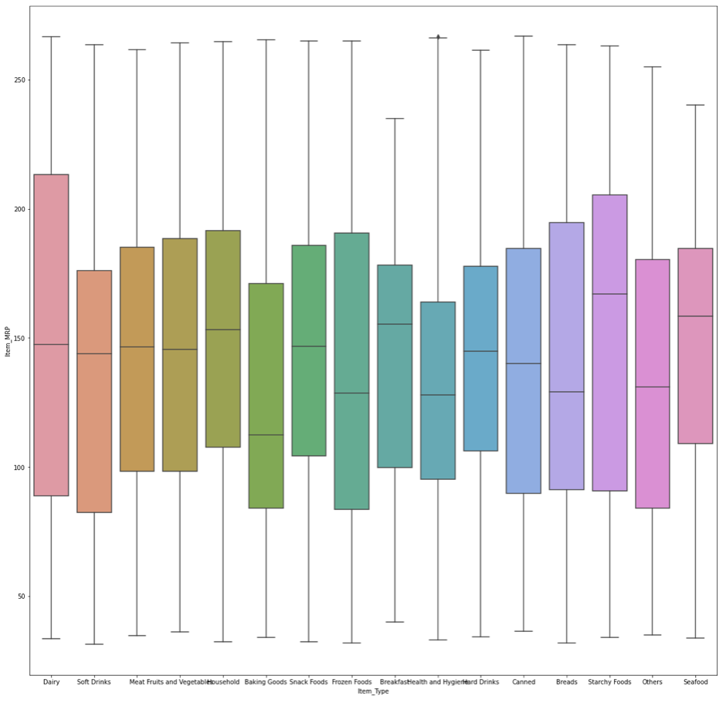
VISUALIZATION 1

Slide 6
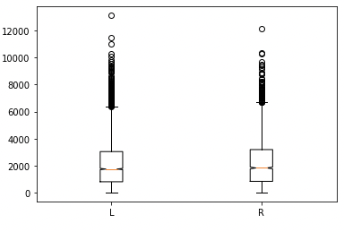
VISUALIZATION 2

Slide 7
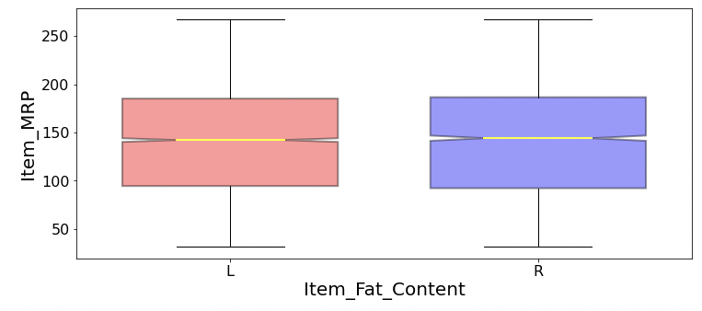
Visualization 3

Slide 8
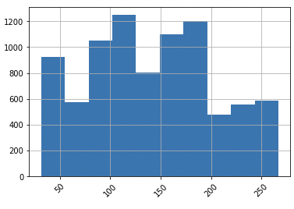
Visualization 4
Retail price

Slide 9
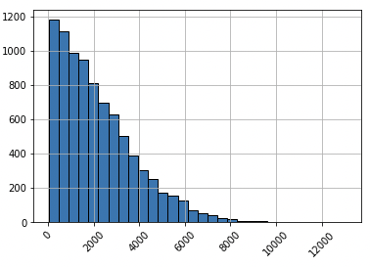
Visualization 5

Slide 10
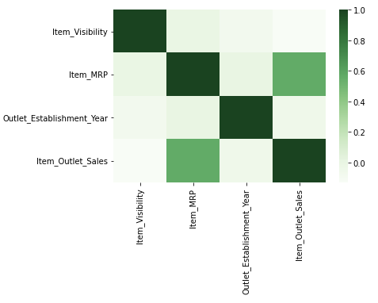
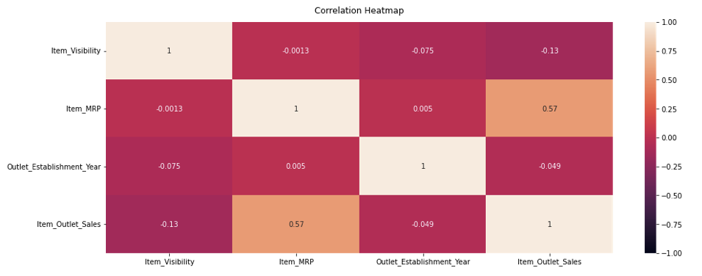
Visualization 6-7

Slide 11
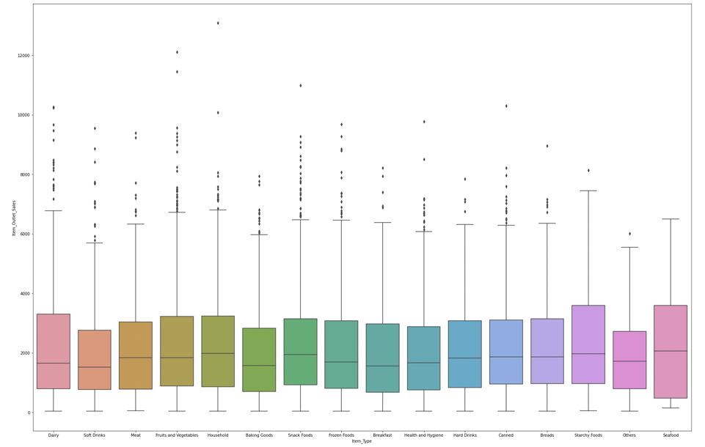
Visualization 8

Slide 12

Part 3 Data exploratory

Slide 13
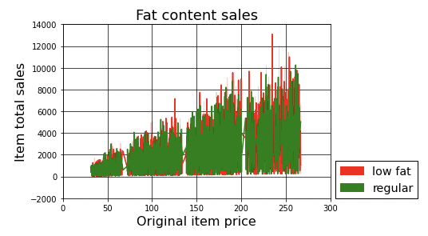
Visualization 9

Slide 14

Part 4
Pre-processing to Machine Learning

Slide 15

Final part
Training models
Regression Model
Simple Decision tree
Bagged trees
Random Forest model

Slide 16

Recommendation
Meat, Fruit and vegetables, Household items ,give the high sales than any other item types, need to be in high quantity to make more profit
Health and hygiene, breads have cheap retail price, which can increase sales as well
Low fat items generate more profit than regular fat items, so selling more low fat items can elevate the sales
Need to sell more Diary and Starchy food items, in spite of their costly retail price
Using random forest model can decrease the error in the change of sales

Slide 17

Improvements
1.More advanced visualizations, like combo statistic features
2. Using advanced machine learning parameters, which can decrease the error
3.Consulting with SME(subject matter expert) to get more insights about data
4.Employing different coding techniques

